Slide 1
Interim Survey Summary
Rush County Demographics

Slide 2
Overview
268 surveys received (10/11/19) of county population 16,663 (2017)
Some of the surveys did had missing answers for 1 or more questions. This marked the survey incomplete in REDcap. Although all questions require a value, people can still start filling out the survey but not submit it. REDcap will still save these uncompleted surveys.
A few of the surveys were just missing the last question. These results can still be used. The IU students will need to delete half-completed surveys from the system once the survey is closed.

Slide 3
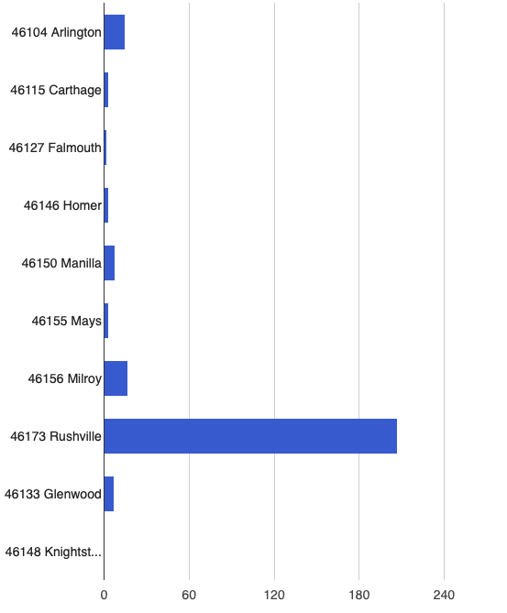
WHAT IS YOUR ZIP CODE?
78.3% - Rushville
6.4% - Milroy
5.6% - Arlington

Slide 4
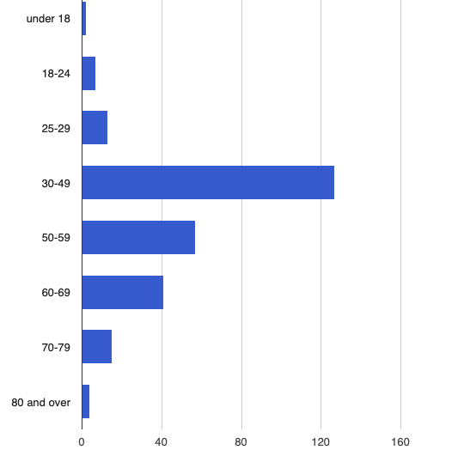
WHAT IS YOUR AGE?
48.1% between 30 – 49
21.3% between 50 – 59
15.3% between 60 – 69

Slide 5
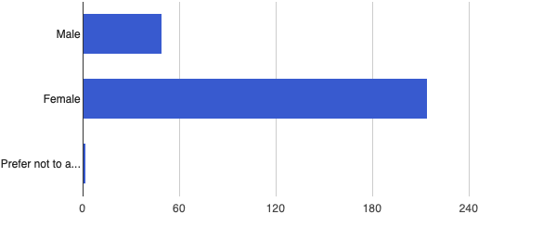
WHAT IS YOUR BIRTH GENDER?
80.5% - Female
18.7 % - Male
0.8 % - Prefer not to answer

Slide 6
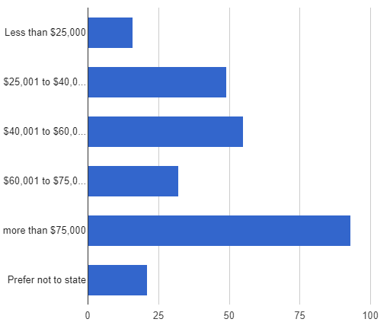
HOW MUCH IS YOUR COMBINED HOUSEHOLD INCOME?
35.0% - more than $75,000
20.7% - $40,001 to $60,000
18.4% - $25,001 to $40,000

Slide 7
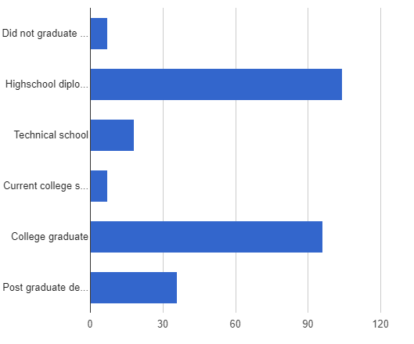
WHAT IS YOUR HIGHEST LEVEL OF EDUCATION COMPLETED?
38.8% - High School Diploma/GED
35.8 % - College Graduate
13.4% - Post Graduate Degree

Slide 8
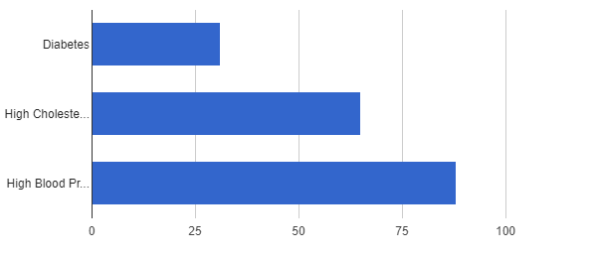
CHECK ALL YOU HAVE BEEN DIAGNOSED AT ANY TIME
27.2% of respondents – Diabetes
57.0% of respondents – High Cholesterol
77% of respondents – High Blood Pressure

Slide 9
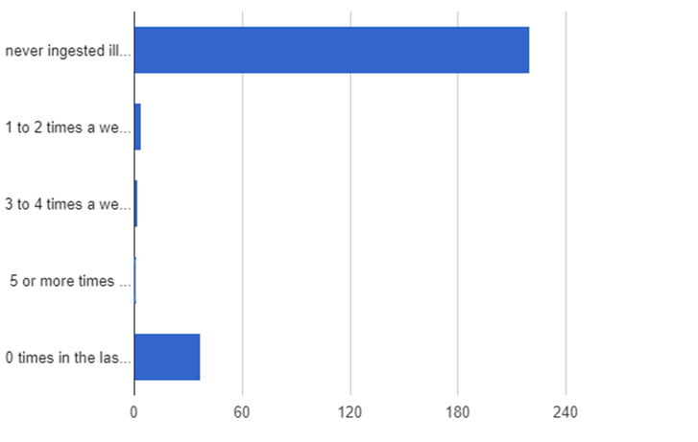
CLOSEST DESCRIPTION OF CONSUMPTION OF ILLEGAL DRUGS OR PRESCRIPTION DRUGS NOT PRESCRIBED TO YOU
97.3% - Never or 0 times in last 30 days
4 people - 1 or 2 times/week
2 people – 3 or 4 times/week
1 person – 5+ times/week

Slide 10
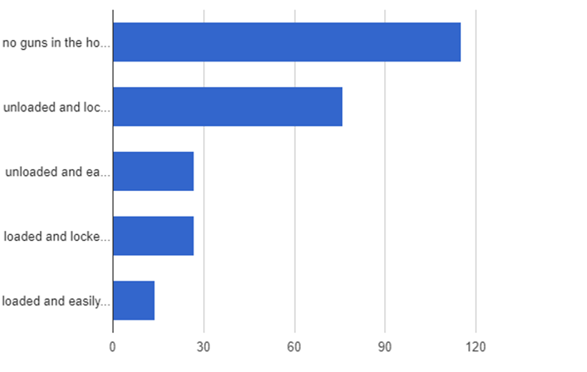
IF GUNS IN HOME, BEST DESCRIBE HOW STORED
44.4% - No guns
29.3% - unloaded & locked away
10.4% - unloaded & easily accessible
10.4% - loaded & locked away
5.4% - loaded & easily accessible

Slide 11
WHAT IS THE TOP HEALTH PRIORITY RUSH COUNTY SHOULD BE ADDRESSING?
#1 – DRUG ABUSE & ADDICTION RECOVERY OPPORTUNITIES (23.5%)
#2 – OBESITY (13.4%)
#3 – MENTAL HEALTH (12.3%)
#4 – NUTRITION/EXERCISE EDUCATION (8.6%)
#5 – HIGH CANCER RATE IN COUNTY (7.1%)
# 6 – VAPING/SMOKING (6.3%)

